Slide 1

Awareness
References…

Slide 2
References
See GitHub for papers on awareness (Dourish, Gutwin)

Slide 3
Definition
Awareness: an understanding of the activities of others, which provides a context for your own activity (Dourish and Bellotti)
Need to consider context and content of individual contributions

Slide 4
Shared workspaces
Primary issue:
Is the information explicitly generated (i.e. separate from the shared object)
Or passively collected and distributed, (and presented in the same shared workspace)
Some systems assign roles thus restricting potential activities but also increasing awareness
Notes:
Awareness is often a secondary goal.

Slide 5
Awareness as an intentional activity?
Not usually – because we often take it for granted in the everyday world
Why is it a problem with computational systems?
Input/output devices do not generate as much perceptual information as real world

Slide 6
Team Cognition -- Framework
Part 1: What information makes up workspace awareness?
Who? Presence, identity, authorship
What? Actions, intentions, artifacts
Where? Location, gaze, view and reach
(see Table 1 in Gutwin’s paper)
Notes:
What are they doing?
What goal is that action part of
What object are they working on

Slide 7
Team Cognition – Framework (2)
Part 2: How is workspace awareness information gathered?
Intentional communication: conversation and gesture
Feedthrough: changes in artifacts (objects and tools)
Consequential communication: Bodies in the workspace
Notes:
Intentional communication: Can also overhear other conversations and so gain awareness, or a running commentary
Bodies: just by seeing people, watching people work in the same workspace – not intentional as far as intentional gestures, pointing to this or that
Changes in artifacts can show what has been done with them, if they are being used. May be shared objects but also shared tools. Can involve sound or sight.
Sometimes feedthrough is the only vehicle for awareness information

Slide 8
Team Cognition – Framework (3)
Part 3: How do teams use workspace awareness?
Management of coupling
Simplification of verbal communication
Deictic references Visual evidence : backchannel feedback
Gaze awareness
Coordination of actions
Can be done explicitly or through workspace awareness
Awareness informs on the temporal and spatial boundaries of others’ actions to track, predict, mesh
Awareness is a two-way street!
Notes:
Coupling: degree to which people are working together – will look for opportunities for closer collaborations when the timing is right
Simpification – making use of a “conversational prop”
Dike-tic reference – this that those pointing – more efficient… fewer words hard to do without gesturing
(experiment with a chair)
Visual evidence – seeing someone you know how they are doing, don’t have to keep asking or checking
The importance of not only you being aware of what I am doing, but also that I am aware that you are aware is needed!
Coordination of actions – right time, in the right order…
Locks may not be that important if we have awareness
Potential discussion topic: What is better RCS or CVS model… and argue why from a CSCW perspective.

Slide 9
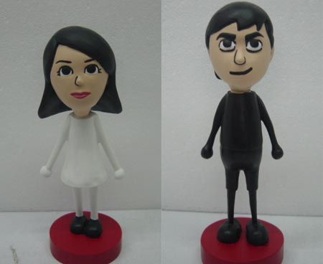
Supporting awareness in software
Embodiments:
Telepointers (additional semantics)
Avatars
Video images (video of what?)

Slide 10
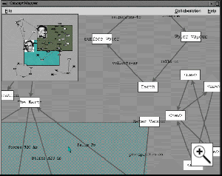
Supporting awareness in software
Expressive artifacts:
Process Feedthrough
Action indicators and animations
Visibility techniques (on one display):
Radar views
Over the shoulder
Cursor’s eye view
Notes:
Symbolic manipulation e.g. using keyboard shortcuts.
Issue balancing feedthrough and occlusion… (e.g. menu example)
Power of “visual momentum”…
Through emphasis
Action indicators – e.g. hear a trash can sound… rather than something just disappearing…
Or draw a text notification
Or gradually fade away
Or visual momentum
Good exam question: different of ots and cursor vs. radar?
We will come back to his experiment and perhaps critique it when we talk about experiments

Slide 11
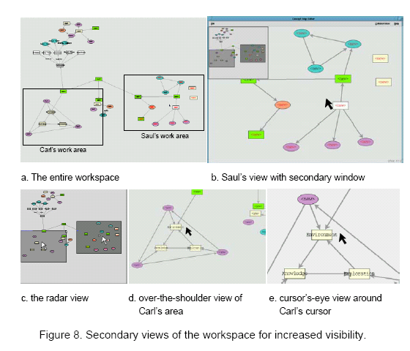
Notes:
Paper then discusses an experiment to show that radar view seems to be preferred in groupware applications.
Other approaches from games that you are aware of?

Slide 12
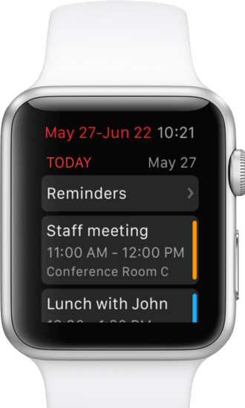
Awareness displays
Awareness on primary displays
Embedded views, e.g. radar views
Tickers
Awareness on secondary displays
InfoCanvas
Ambient Awareness Displays
Visual awareness
Auditory awareness
Awareness on mobile devices
Notes:
Use of a secondary display
Blackberry little red light flashing
Other examples?

Slide 13
Socially translucent systems
Systems that provide perceptually based information about the presence and activity of users
Provides social resources for the group and individuals to structure and enhance their online interactions
Visibility yields awareness yields accountability
“Social translucent systems make it easier for people to interact in purposeful ways, to observe and imitate others, to engage in peer pressure, to create, notice and conform to social conventions”
Notes:
Not in readings…
With visibility comes awareness which yields a sense of responsibility
Mention reviewing of peer articles

Slide 14
Babble
Babble is an infrastructure for a knowledge community
It is an online, digital space in which knowledge can be created, discovered, shared and reused
Provides support for expressive communication through informal conversation
Notes:
In KM – too much emphasis is placed on capturing existing knowledge and not enough on the creation of new knowledge.
The idea is to provide a digital collaborative substrate as the infrastructure for KM rather than a database
Conversation is a fundamentally important social process -- blend work and social activities

Slide 15
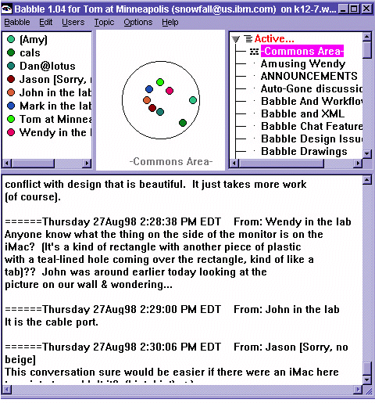
Babble’s user interface
Notes:
The Users List
In the upper left pane of the Babble window (Figure 3) is a list of the names of all users who are logged on, each shown with his or her marble (i.e. the colored dots).
The Social Proxy
The upper middle pane contains the social proxy (usually called 'the cookie'), which here shows that all 8 participants are in the current conversation (in this case, the "Commons Area"). Two of these participants have not been recently active; the other six have all 'spoken' or 'listened' (i.e. interacted with the Babble window) recently. Over the course of several minutes of inactivity, a participant's marble drifts towards the periphery.
The Topics List
The upper right pane shows a list of all topics (i.e. conversations), with the currently viewed topic highlighted. Clicking on a topic moves the user to that topic, resulting in the conversation being displayed in the bottom pane of the window, and in the user's marble moving out of the circle (from the perspective of the other participants). Miniature icons to the left of each topic name indicate how many people are in it (to a maximum of 10), and the topic changes color when new material is added. Topics can be created or deleted by anyone.
Talking via the Topic Window and Chat
The bottom pane holds the topic's conversation which consists of a shared sequential structure in a single, persistent document. People 'talk' by typing into an entry window; if they select text before beginning, the selected text is 'quoted' and displayed in the entry window. In either case, once the text is composed, the user clicks a "Done" button and the comment is appended to the end of the conversation, with a name and time stamp.
Babble also supports private, one-to-one chat. By right-clicking on a participant's name or marble, a user can initiate a private chat. One experimental feature is that soft key click sounds are transmitted in real time, giving the chat partner cues as to whether and how extensively the chatter is responding; the actual text of the comment is not sent until the chatter clicks "Done." Although chats are not persistent, participants can, and sometimes do, copy portions of private chats into public conversations.
Other Features
The Babble interface also includes a second, very small window called "the spot" (not shown), which turns green whenever a new message appears in the current conversation. This allows users to minimize the Babble window, using the spot as a monitor for conversational activity while they perform other tasks on their workstations. Clicking on the spot brings up the Babble Window, with new comments temporarily highlighted.
Another feature is the ability to get information about users' activities by right-clicking on their marbles and choosing "Get Info...". This reveals where the user is, and when they were last present in the current topic. This is another way of supporting awareness and accountability.

Slide 16
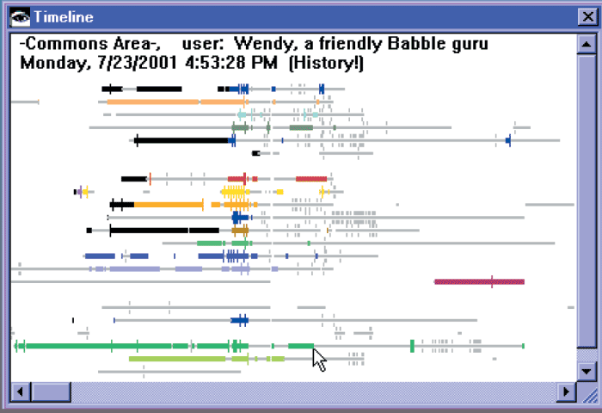
The Timeline in Babble
Notes:
Social proxy just shows a snapshot in time… consequently they developed the timeline to to act as an asynchronous social proxy….
The basic goal of the timeline is to provide a way for a “speaker” to see that people were “listening” (or not), even when the listening was offset in time. Each user logged on to Babble is represented by a row. When the user “speaks,” a vertical mark or blip appears on the line. If the line/blip is in color, it means the user was active in the conversation currently being viewed by the user of the timeline; otherwise the line/blip is shown in gray (and the line is thinner). As the user moves the mouse over the timeline, the name of the topic, the user, and the time being examined are shown in the upper left corner of the window; the user can scroll back through as much as one week of activity. Other functions of the timeline may be invoked by right-clicking on another user's row (e.g., private chats).
The timeline in Figure 2 covers about half a day's worth of activity. We can see that over the course of the afternoon about 20 people have logged onto Babble (shown by the number of rows), most of them have spent some time in the current conversation (shown by the color/increased thickness of the lines), and many, but not all, have “spoken” (shown by the blips). Gaps in the line indicate intervals when the person logged off. In the center of the timeline, a flurry of concentrated activity can be seen. This represents an on-line brainstorming session that took place in midafternoon, involving a majority of the people who logged onto Babble that day.
Note that a lack of activity here could have been due to a conference call that was occurding at the same time. Can ‘see’ people reading messages when they log on.

Slide 17
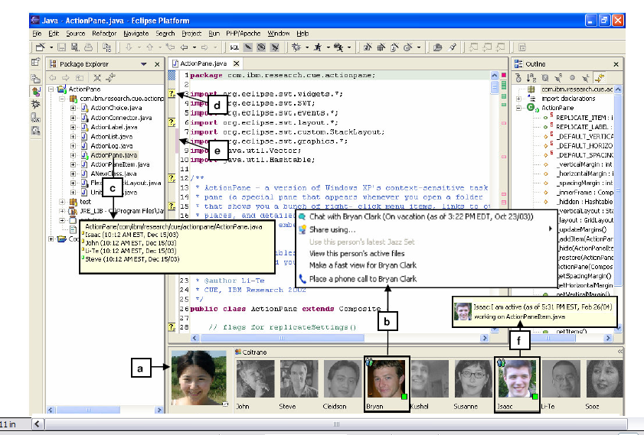
Jazz

Slide 18
Tradeoffs in Awareness support systems
Awareness
and
Disruption
Privacy
and
Visibility!
Generally assumed to be better if we have continuous interactions rather than explicit connections between individuals
Notes:
More information you share about yourself, the more awareness your colleagues have about you, but the less privacy you have.
And the more information I share with you, the more likely it is to disrupt you… if I update you everytime I read/stop reading email.
Better to have continusous interactions rather than explicit connections

Slide 19
Discussion
What systems provide social translucence today and how?

